Slide 1
Clothing brand website
Partners: Fatima Yousaf and Aqsa Nazkat

Slide 2
Purpose
Fashion Expression: Provide a platform for individuals to express their unique style
2. Quality and Comfort: Prioritize high-quality materials and comfortable designs.
3. Inclusivity: Embrace diversity in sizing, styles, and models.
4. Sustainability: Incorporate eco-friendly practices and materials.
5. Affordability and Accessibility: Offer a variety of price points to make stylish clothing accessible.
6. Customer Experience: Focus on a seamless online shopping experience.
7. Trendsetting Designs: Stay ahead of fashion trends and provide innovative, unique designs.
8. Community Engagement: Foster a sense of community by engaging customers through social media.
9. Ethical Practices : Ensure ethical sourcing and manufacturing processes.
10. Personalization: Integrate personalized shopping experiences, such as style quizzes.

Slide 3
Targeted Audience
Online Shoppers
Diverse Demographics
Online Shoppers
Conscious Consumers
Community-Driven Individuals
Budget-Conscious
Shoppers Work and Casual Wear
Consumers Body Positivity Advocates

Slide 4
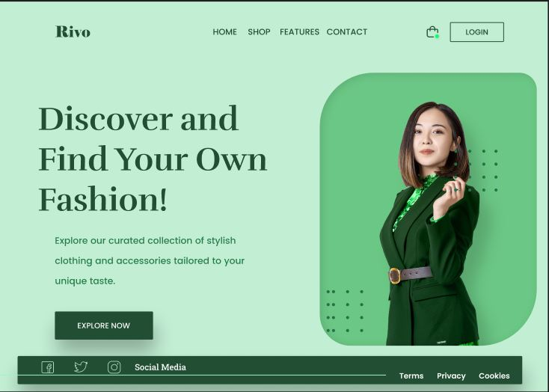
PROTOTYPE

Slide 5
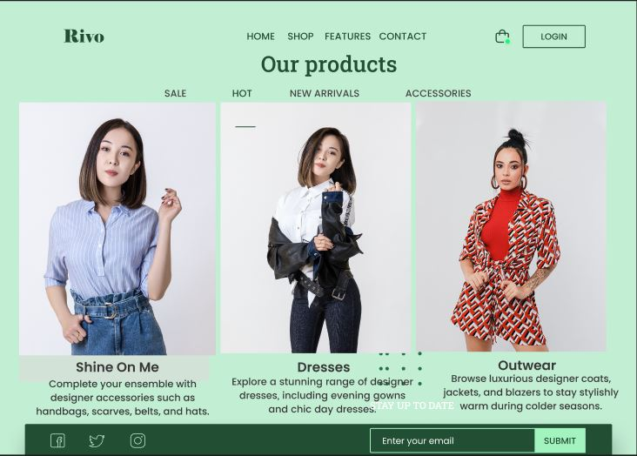
PROTOTYPE

Slide 6
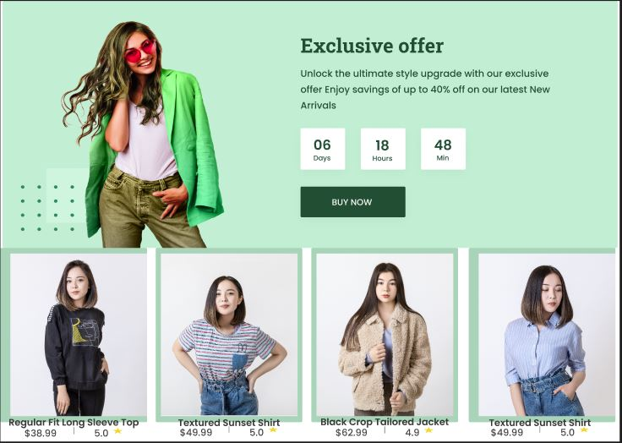
PROTOTYPE

